Slide 1
Skoltech
Neurons and Networks of Neurons in Python and MPI
Rabia Khan

Slide 2
Outline
Introduction
Steps for Neuron Scripting
MPI for neuron

Slide 3
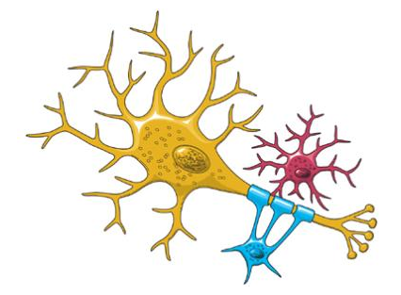
Introduction to Neuron
The NEURON simulation environment is a powerful engine for performing simulations of neurons and biophysical neural networks. It permits the construction of biologically realistic membranes with active and passive ion channels, combined with virtual connectivity and electrophysiology tools to drive and measure neuron and network behaviours.
Notes:
Place results in context
What was already done?
How your results fit?
Are they new?
So What

Slide 4
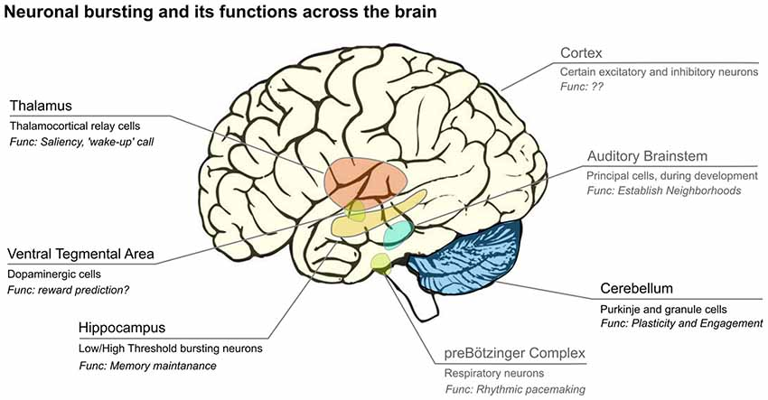
Spikes from Neurons
Neurons in the brain respond to (sensory) stimuli by generating electrical pulses called ‘spikes’ or ‘action potentials’. Spikes are organized in different temporal patterns, such as ‘bursts’ in which they occur at a high frequency followed by a period of silence.
Depending on the stimulus, the brain area and the cell-type, spike trains can be regular, irregular, or show intricate temporal patterns.

Slide 5
Scripting NEURON basics
Step 1: Import the neuron module into Python
Step 2: Create a cell
Step 3: Set the cell's morphological properties
Step 4: Insert ion channels
Step 5: Insert a stimulus
Step 6: Set up recording variables
Step 7: Run the simulation
Step 8: Plot the results
Step 9: Saving and loading results

Slide 6
Scripting NEURON basics
Step 1: Import the neuron module into Python
import neuron
from neuron import h
from neuron import h, rxd
from neuron.units import ms, mV
Step 2: Create a cell
soma = h.Section(name='soma’)
h.topology()
soma.psection()
soma.L

Slide 7
Scripting NEURON basics
Step 3: Set the cell's morphological properties
soma.L = 20
soma.diam = 20
Aside 3: Python's dir function
dir(soma)
import textwrap
print(textwrap.fill(', '.join(dir(h))))
Aside 4: Getting more help
help(soma.connect)
?soma.connect

Slide 8
Scripting NEURON basics
Step 4: Insert ion channels
soma.insert('hh’)
Aside 5: Sections and segments
Section: section
Segment: section(loc)
print("type(soma) = {}".format(type(soma)))
print("type(soma(0.5)) = {}".format(type(soma(0.5))))
Aside 6: Accessing segment variables
section(loc).var
section(loc).mech.var or section(loc).var_mech # for mechanisms on the segment
mech = soma(0.5).hh
print(dir(mech))
print(mech.gkbar)
print(soma(0.5).hh.gkbar)
Step 5: Insert a stimulus

Slide 9
Scripting NEURON basics
Step 5: Insert a stimulus
iclamp = h.IClamp(soma(0.5))
print([item for item in dir(iclamp) if not item.startswith('__')])
iclamp.delay = 2
iclamp.dur = 0.1
iclamp.amp = 0.9
soma.psection()

Slide 10
Scripting NEURON basics
Step 6: Set up recording variables
iclamp = h.IClamp(soma(0.5))
iclamp.delay = 2
iclamp.dur = 0.1
iclamp.amp = 0.9
soma.psection()
Step 7: Run the simulation
v = h.Vector().record(soma(0.5)._ref_v) # Membrane potential vector
t = h.Vector().record(h._ref_t) # Time stamp vector

Slide 11
Scripting NEURON basics
Step 8: Plot the results
h.load_file('stdrun.hoc')
h.finitialize(-65 * mV)
h.continuerun(40 * ms)
Step 9: Saving and loading results
CSV: import csv
Reading and plotting using plotnine and pandas:
import plotnine as p9
import pandas as pd
JSON: import json
Pickles: import pickle

Slide 12
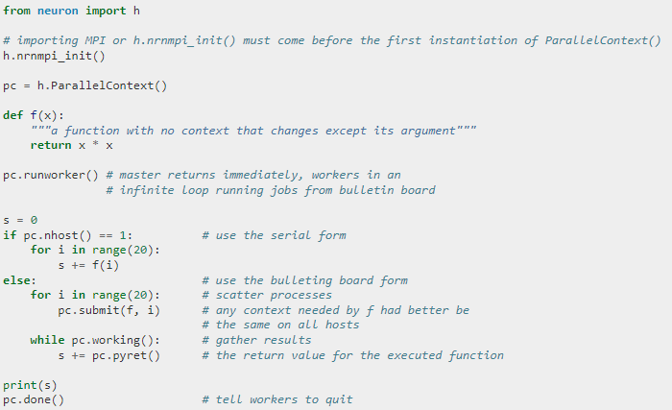
Neuron with MPI

Slide 13
Conclusion
Introduction to Neurons
Basic step required to script neuron
Use MPI with neuron
Split Cells into subsections for parallel execution or cells into different cpus.

